Slide 1

COVID-19 CONTACT
TRACKING FOR THE
WIDER GLOBAL
COMMUNITY
ON THE RIGHT TRACK
BENJAMIN HUME – MOUNT ALBERT GRAMMAR SCHOOL

Slide 2

INTRODUCTION
Ultimately, I decided that contact tracing would be the most suitable focus for my inquiry. Firstly, most of the world still lacks access to a reliable method of contact tracing. This is a great concern as contact tracing has proven to be critical to the containment of COVID-19, especially in post-lockdown communities. Secondly, the COVID-19 pandemic is a far more prevalent issue in 2021 than either of the alternate inquiry focuses. For these reasons I decided to focus on COVID-19 contact tracing; if the effects of COVID-19 are to be mitigated, a simple but effective open-source tracing software should be developed with an international audience in mind.

Slide 3
INTRODUCTION
I will be designing and developing a digital technology outcome with the aim of solving or assisting the solution of a prevalent issue.
In order to identify the most suitable focus I first devised several focuses, before narrowing it down to the most appropriate option based upon the importance of the issue and my ability to solve it. I investigated issues faced by communities around the world on a regular basis, recording issues which showed a significant prevalence. Among these recorded focuses were:
- Emergency service call training
- Cyber security training
- COVID-19 Contact tracking

Slide 4
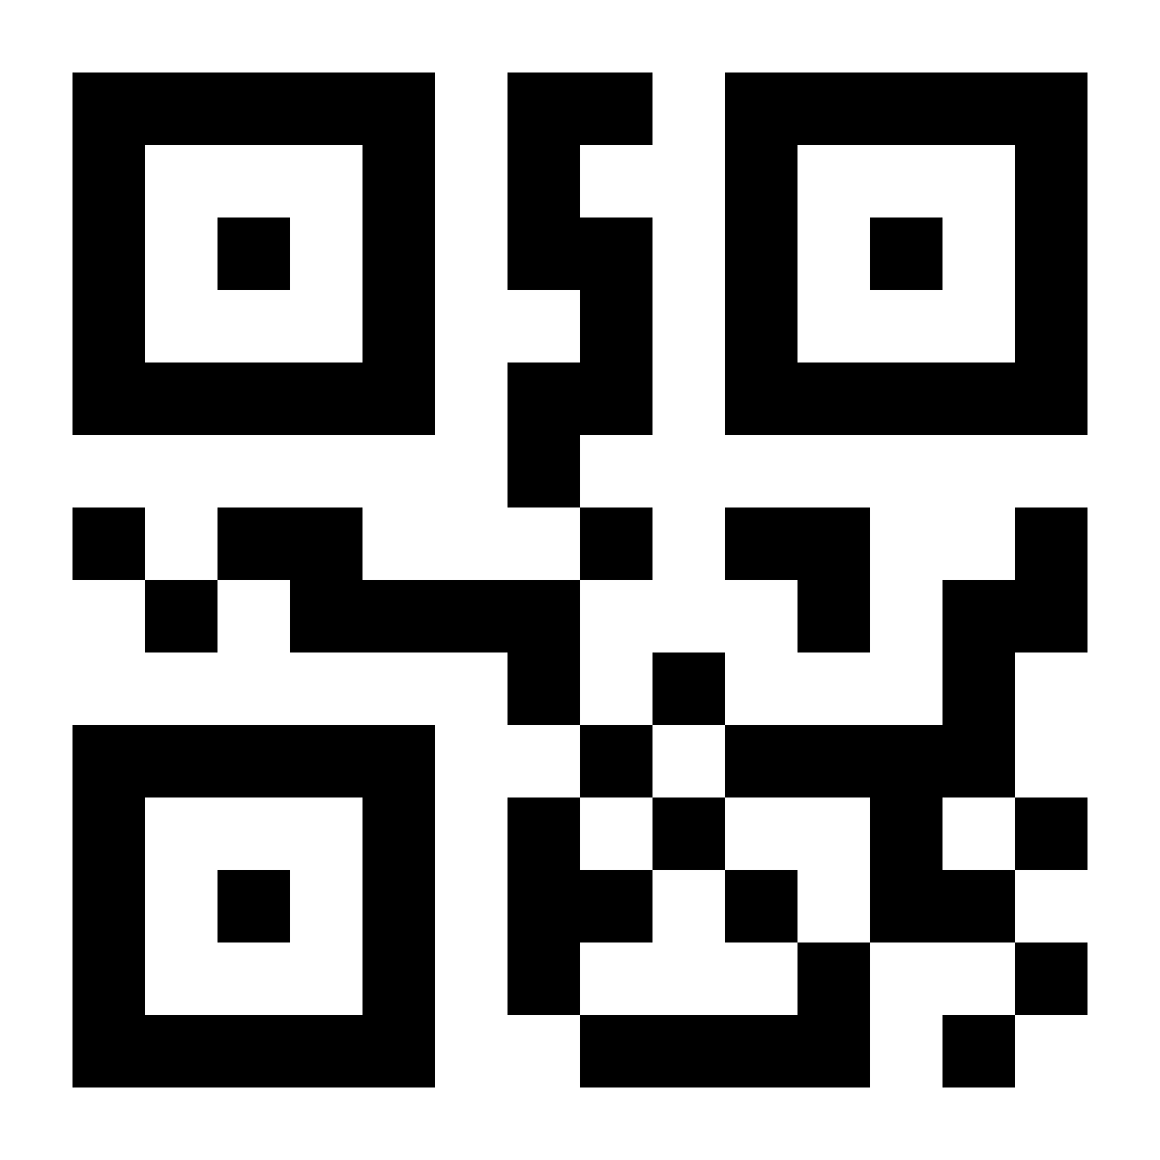
WHY REINVENT THE WHEEL?
But why build a new contact tracker from the ground up when New Zealand already has one? While our government has the resources available to produce and support its own contact tracking software, many communities around the world do not. This leaves smaller communities without access to reliable and effective contact tracking. I have developed my own contact tracking software with the goal of building a program that can be easily modified by small communities, giving them access to simple, but effective, contact tracking.

Slide 5
WHY REINVENT THE WHEEL?
Adapting a pre-existing contact tracing system or developing an entirely new one can be time consuming and costly for smaller communities. By developing an easily adaptable open-source Python program with an emphasis on easy modification, I am able to provide reliable contact tracing to smaller communities at a very low cost. Rather than allocating funds to their own contact racing program or an outsourced alternative, authorities of smaller communities can, with little technical experience, adapt this pre-existing application to facilitate their community’s needs. Furthermore, developing this application in Python allows smaller communities to easily adapt the program to work with their own API's and even integrate their own language settings.

Slide 6

RESEARCH
After conducting research into how different factors contribute to the effectiveness of contact tracing, I was able to format my findings into a series of collated conclusions.

Slide 7
RESEARCH
“Appealing to customers’ brains (knowledge) rather than their hearts (emotions) can increase the effectiveness of contact tracing as people are more likely to participate” - Dr Raymond Xia. An individual is more likely to participate in a contact tracing system if they think that it is reliable. In systems where there is skepticism, far fewer individuals tend to participate, reducing the effectiveness of the contact tracing system. To increase the effectiveness of contact tracing the system should demonstrate “demonstrate professionalism, competence, and reliability”.

Slide 8
RESEARCH
Contact tracing systems rely on the ability to respond quickly to a case, the efficiency of a system will be reduced if it is not time optimized as the timeframe the infected individual has to spread the virus before they are isolated is increased. Reducing the time taken for authorities to follow an infection case can reduce the spread of the virus as the window of time in which the virus can be spread is reduced.

Slide 9
RESEARCH
Personal benefit has also been identified as a key factor which increases the likelihood of an individual participating in the contact tracing process. If an individual can gain something by participating, for example entry to an establishment, they are far more likely to participate. Adding some form of personal gain or euphoric response can increase the effectiveness of a contact tracing system.

Slide 10
RESEARCH
// SOURCES
Prof Mirjam E Kretzschmar, PhD ., Ganna Rozhnova, PhD ., Martin C J Bootsma, PhD ., Michiel van Boven, PhD ., Prof Janneke H H M van de Wijgert, PhD ., Prof Marc J M Bonten, MD ., (2020), Impact of delays on effectiveness of contact tracing strategies for COVID-19: a modelling study, (1st ed.), The Lancet Public Health – Recent (2020), No bias identified as the organization is non-prophet with no clear agenda, peer reviewed, Verdict: Credible
Jonatan Almagor., Stefano Picascia., (2020), Exploring the effectiveness of a COVID-19 contact tracing app using an agent-based model, (1st ed.), Nature.com - Recent, Possible bias as Nature.com profits from their articles however there appears to be no bias as there is no clear fear mongering or click-baiting, peer reviewed, Verdict: Credible
Unknown NCIB Scientist., (2020), Facilitators and barriers to engagement with contact tracing during infectious disease outbreaks: A rapid review of the evidence, (1st ed.), NCIB - Recent, NCIB is a reliable government organization which is held with high esteem in the scientific community (no bias identified), peer reviewed, Verdict: Credible
Matt J Keeling., Deirdre Hollingsworth., Jonathan M Read., (2020), Efficacy of contact tracing for the containment of the 2019 novel coronavirus (COVID-19), (1st ed.), BMJ Journals - Recent, Possible bias as BMJ profits from their articles however there appears to be no bias as the information is presented for purely scientific purposes, peer reviewed, Verdict: Credible
Dr Raymond Xia., Mark Hathaway., (2021), Study examines keys to success for contact tracing, (1st ed.), University of Otago - Recent, No bias identified, peer reviewed, Verdict: Credible

Slide 11
C://DEVELOPMENT
01
02
03
04
05
06
07
08
09
10
11
12
13
def(“The contact tracker is built in Python, a basic programing language with lots of online documentation. This makes it ideal for a program that is designed to be changed to fit the needs of each user.”):
print(”My program features a plethora of different public APIs, modules, and libraries, including:” ) + \n
Kivy = “A library of resources and scripts used to make the GUI (Graphical User Interface).”
COVID = “An API which connects to the John Hopkin’s university virus database to get COVID-19 stats.”
Date Time = “A module which accesses the date and time from the user’s device.”
AST = “A module which allows different types of data (integers, strings, lists, etc.) to be automatically converted to any data type.”

Slide 12
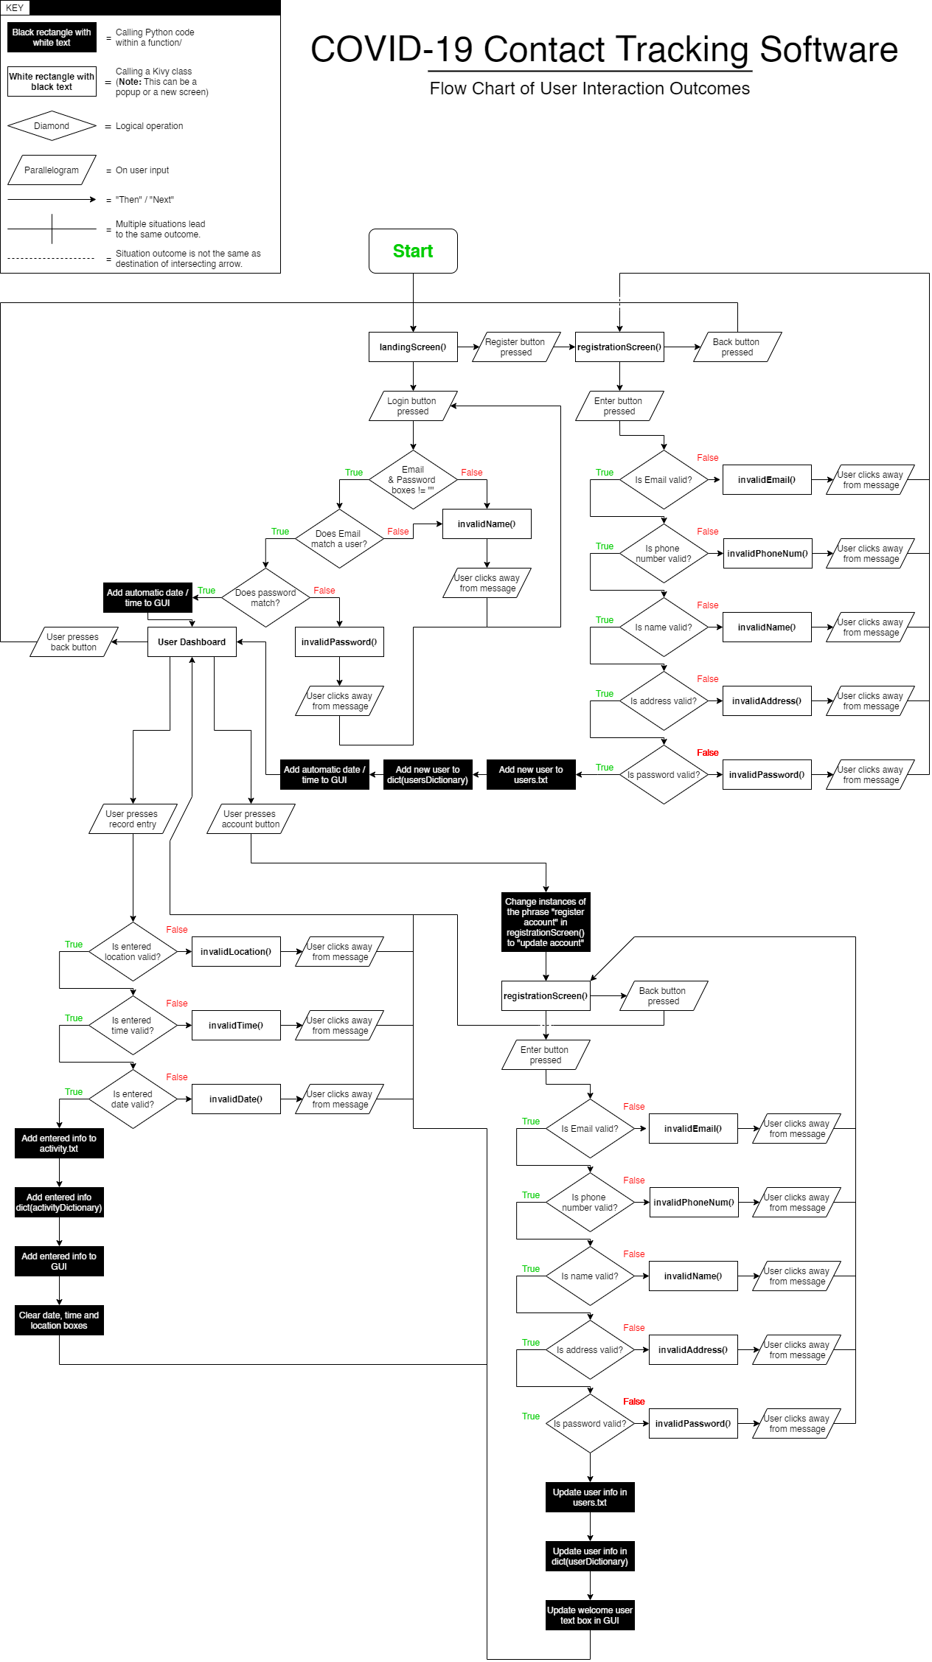
DEVELOPMENT
// FLOWCHART

Slide 13

DESIGN
The aesthetics of my GUI have been thoroughly considered to produce the professional but visually pleasing tone I had envisioned. I chose to use IBM Plex Sans to achieve a modern, professional feel. In combination with this font choice, I decided to use suitably minimalist geometric GUI features to compliment the GUI text. Buttons and entry boxes have clean, contrasting edges which assist their usability factor while bringing the entire GUI closer to the modern aesthetic I have aimed for. Finally, I have incorporated smooth scrolling transitions between each screen and subtle “bump” animations that each button will repeat when clicked, providing tactile feedback to the user, and making the GUI more fun to use.

Slide 14
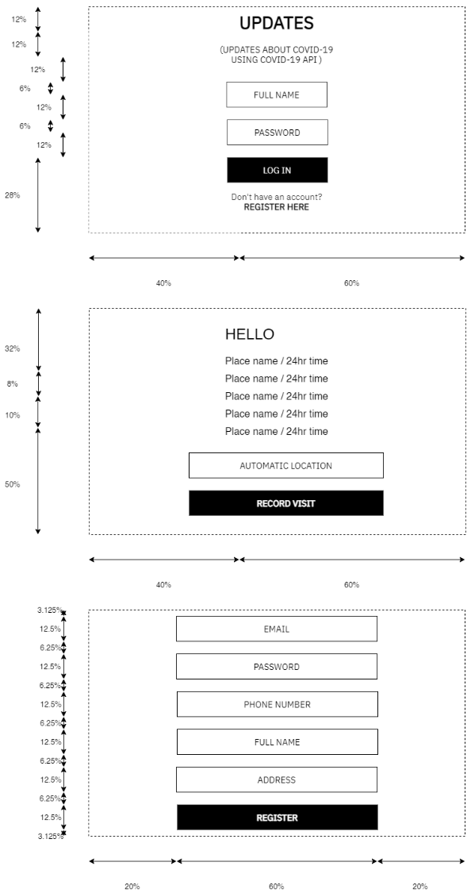
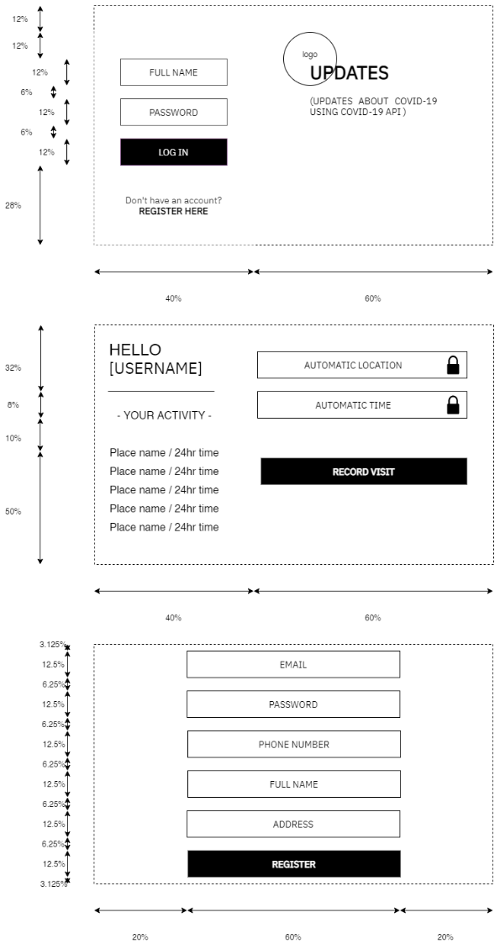
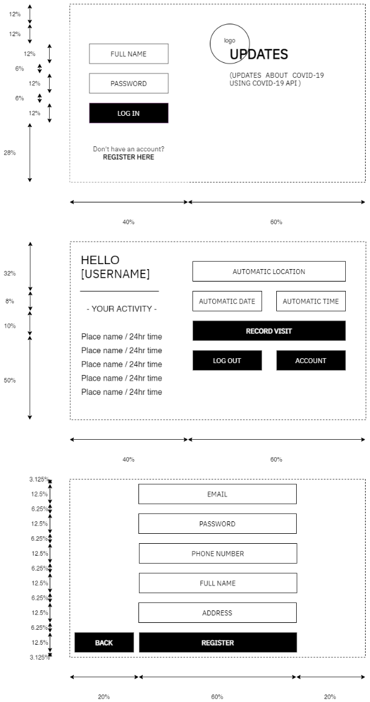
DESIGN
// DEVELOPMENT OF LAYOUT

Slide 15
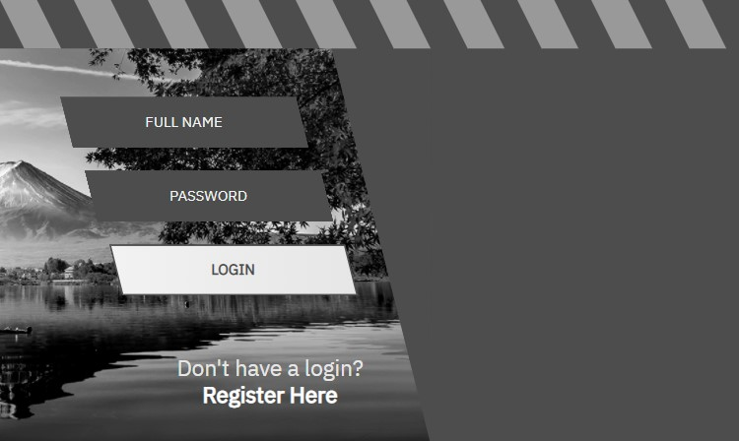

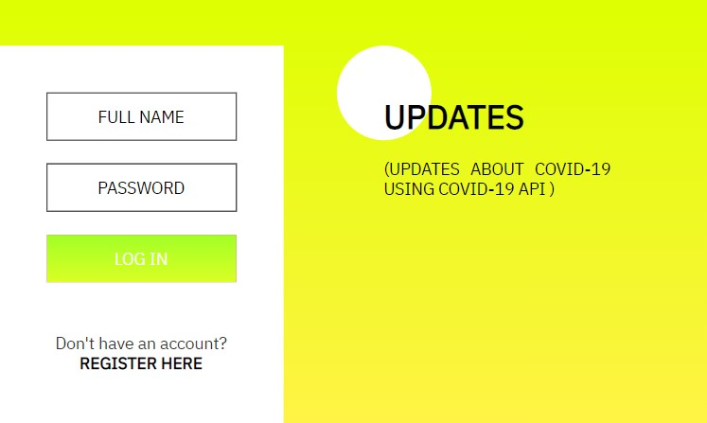
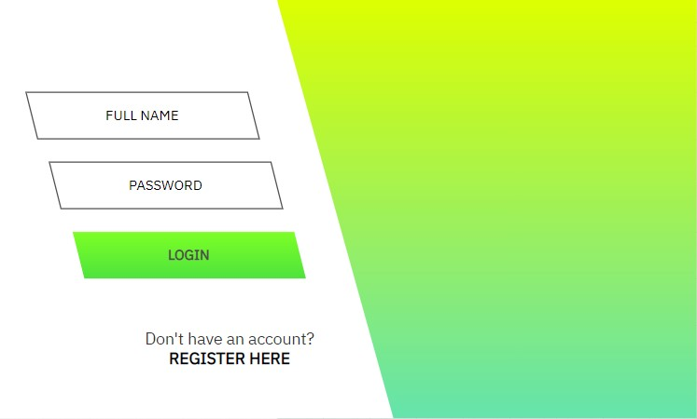
DESIGN
// CONCEPT DESIGNS

Slide 16
DESIGN
// CONCEPT DESIGNS
Eventually this design was chosen.

Slide 17


THE SCIENCE OF COLOUR
In order to mitigate the effects of eye strain, I have considered the size of all elements in the GUI, especially text, so that users do not damage their iris while viewing GUI features and reading GUI information. Additionally, I have implemented five different colour schemes that change automatically depending on the time of day that the application is opened. Each colour scheme is designed for a specific brightness and to contain different amounts of blue light. For example, the colour scheme that the user will get during the night contains a dark grey background with light grey text, whereas the mid-day colour scheme utilizes a white background with black text. Regardless of what time the user opens the application, the overall light emitted by the GUI will match their environment and their natural body clock.

Slide 18
THE SCIENCE OF COLOUR
This prevents excessive amounts of light from entering the eye and damaging the retina. Absorption of blue light by the eyes has been linked to preventing the secretion of hormones that would usually allow us to sleep. Absorbing excess blue light during the evening can have a profound effect on our ability to sleep, however absorbing excess blue light before bed can delay the release of hormones massively because our internal body clock is ignored in favor of what our body believes to be daylight. This can lead to changes in our sleep pattern and delayed tiredness, usually resulting in a harmful lack of sleep. In order to avoid this, each colour scheme has been designed to reduce the user’s blue light intake gradually throughout the day, changing the background gradient colour from green, to blue, to orange, to red and eventually to a dark grey colour gradient containing almost no blue light.

Slide 19
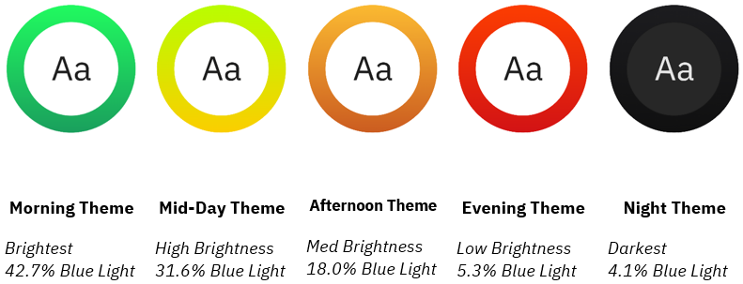
THE SCIENCE OF COLOUR
* Blue light is calculated by dividing the RGB blue value by 255.

Slide 20

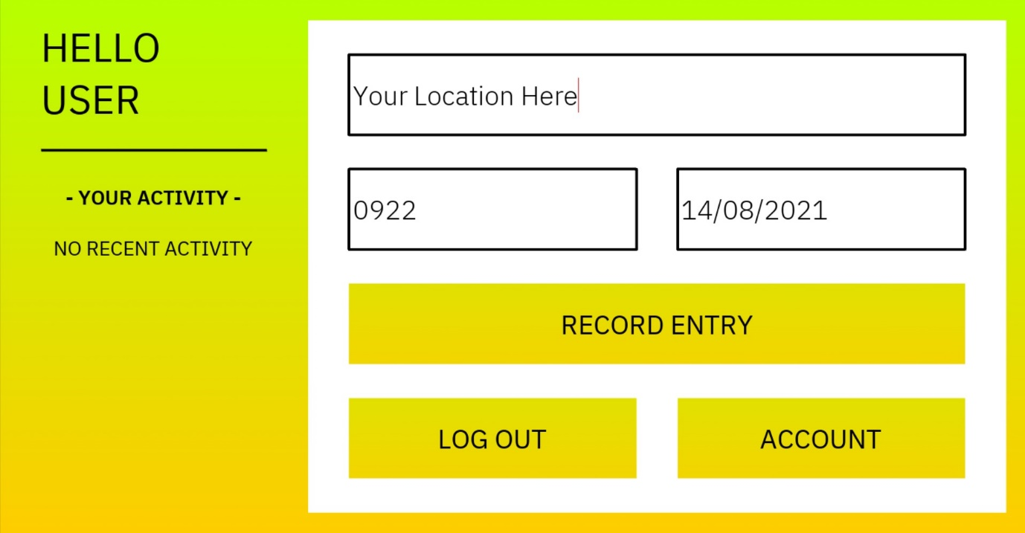
ACCESSIBILITY
In order to make my GUI colour-blind friendly, I have tested all UI colour combinations before implementing them using the Coblis colour blind simulator. I specifically investigated whether the contrast between the colours a colour blind user would see is sufficient, as if this were not the case the application would be significantly more difficult for a colour blind person to use. Not all users with a visual impairment are colour blind, however. In fact, the majority of visual impairments are minor. 43% of all visual impairments are caused by refractive errors in the lens of the eye while a further 33% are attributed to cataracts. While these users still retain most of their visual abilities, they may be unable to identify or position their cursor over smaller or less visually obvious elements.

Slide 21
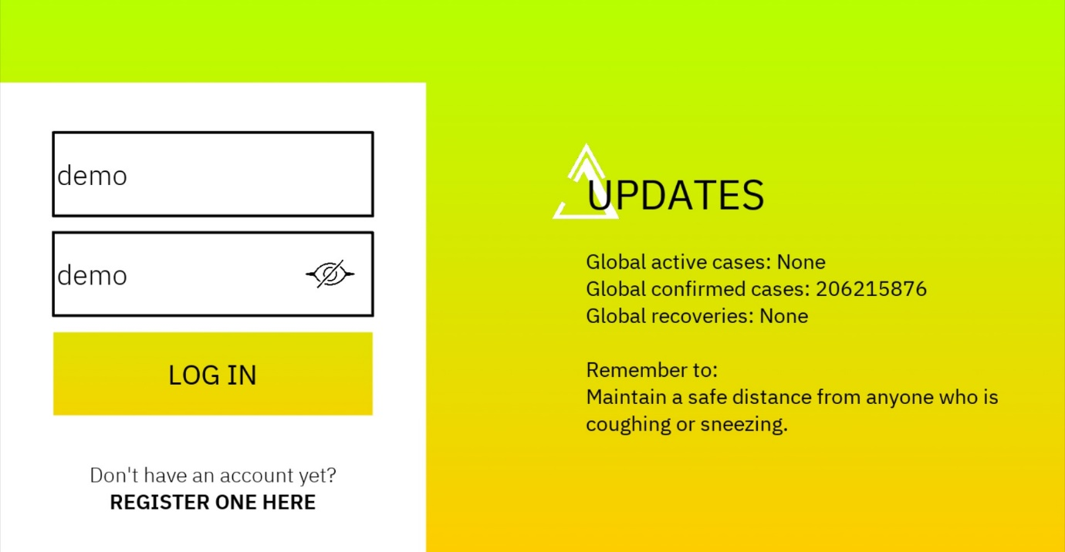
ACCESSIBILITY
Making these elements larger also assists users with limited motor skills, as positioning the cursor over a larger object is far less challenging than positioning it over the element’s smaller alternative. I have chosen to use bold, easily readable fonts in conjunction with contrasting colours and appropriate font size and spacing in order to make text easily readable for all users. Finally, I have used tactile GUI features such as button animations and responsive visual changes to user input in order to make using the program more intuitive to users with limited or otherwise different cognitive abilities. In order to account for the widest range of users, I have made all elements of the GUI large enough and with enough tone and colour contrast to be easily identifiable by users with minor visual impairments.

Slide 22

SUSTAINABILITY AND FUTUREPROOFING
My program has been designed to use as little processing power as possible, code from the account creation screen is even repurposed in order to produce the update account screen, thereby minimizing the amount of code that has to be run during each frame. I am confident that my program uses a negligible amount of power when running on the user’s device, thereby allowing for sustainable operation over a long period of time without waste of power.

Slide 23
SUSTAINABILITY AND FUTUREPROOFING
Furthermore, this allows the program to be used on a variety of older or less powerful devices, meaning that users will not have to buy a new device to take part in contact tracing. This increases sustainability as devices can be used for longer before they fall out of use, meaning that resources do not need to be spent to build new devices. The process of creating a new device also produces large amounts of carbon waste, this is worsened by the carbon waste created shipping the device from the manufacturing site to the user.

Slide 24
SUSTAINABILITY AND FUTUREPROOFING
Ultimately, ensuring the longevity of older devices is very important to environmental sustainability. My application is also relatively futureproof because it has been designed with future alteration in mind. Comments within the code clearly outline the purpose of each class and function, this allows future stakeholders to modify the program for any future COVID-19 outbreaks. Once the COVID-19 pandemic is inevitably brought under control, the application may be modified to allow for effective contact tracing of other viruses.

Slide 25
SUSTAINABILITY AND FUTUREPROOFING
Furthermore, I have chosen a robust GUI system which is cross-compatible to a range of operating systems and will likely be supported far into the future, allowing the program to be functional even after the pandemic officially ends

Slide 26
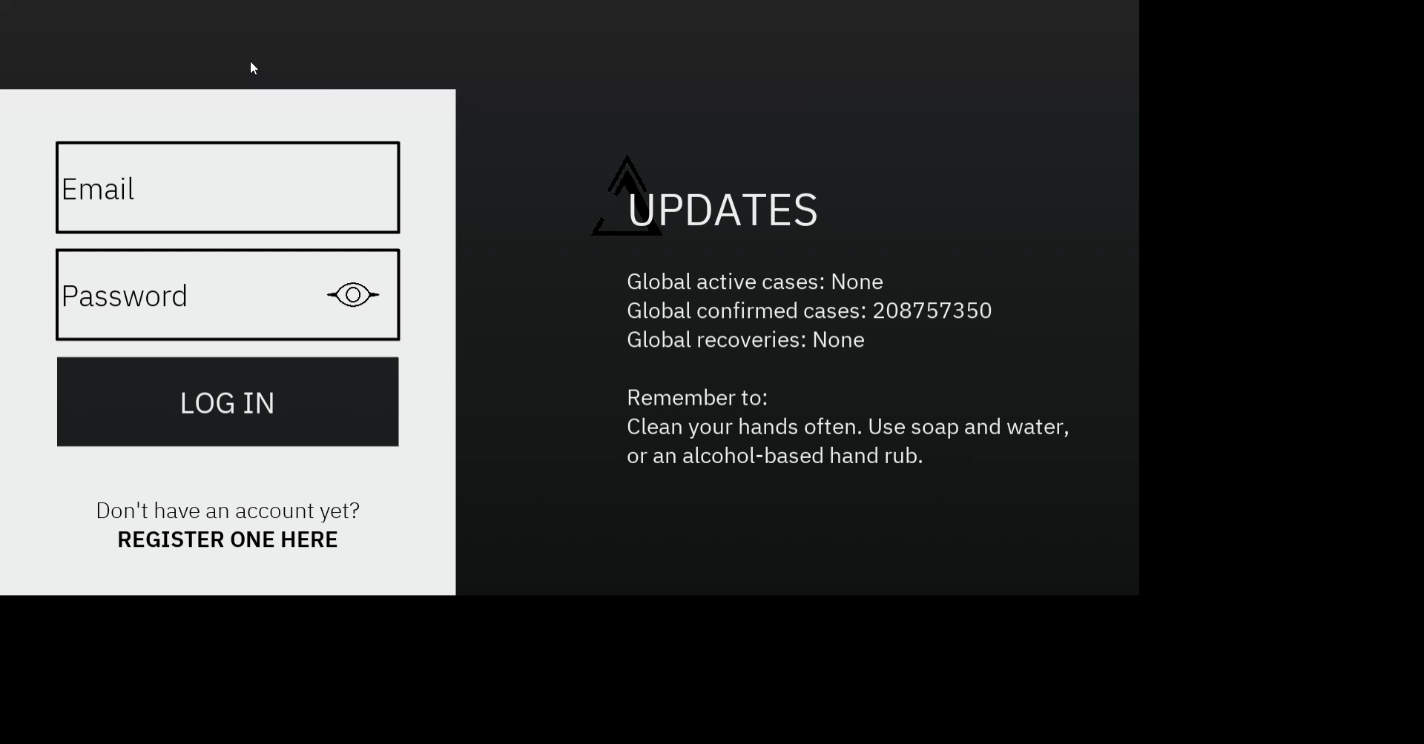
THE FINISHED PROTOTYPE
https://drive.google.com/file/d/1TANwhQFYeNSkRHRYIAoUAaOWzPZ50IA5/view?usp=sharing
Demo of data entry,
(GUI is dark during the night).

Slide 27
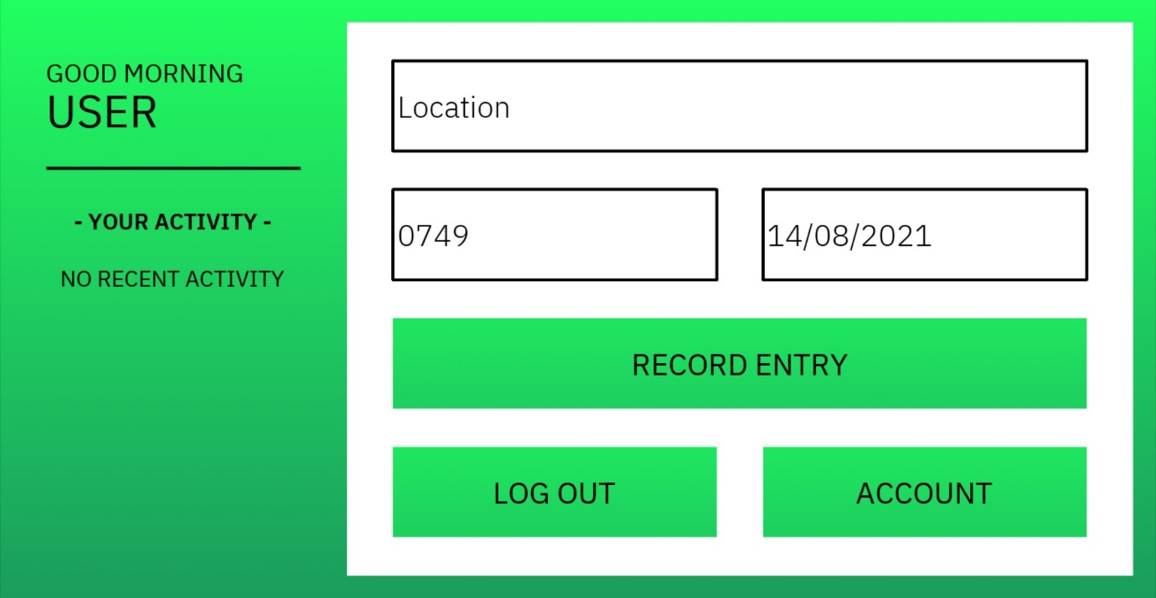
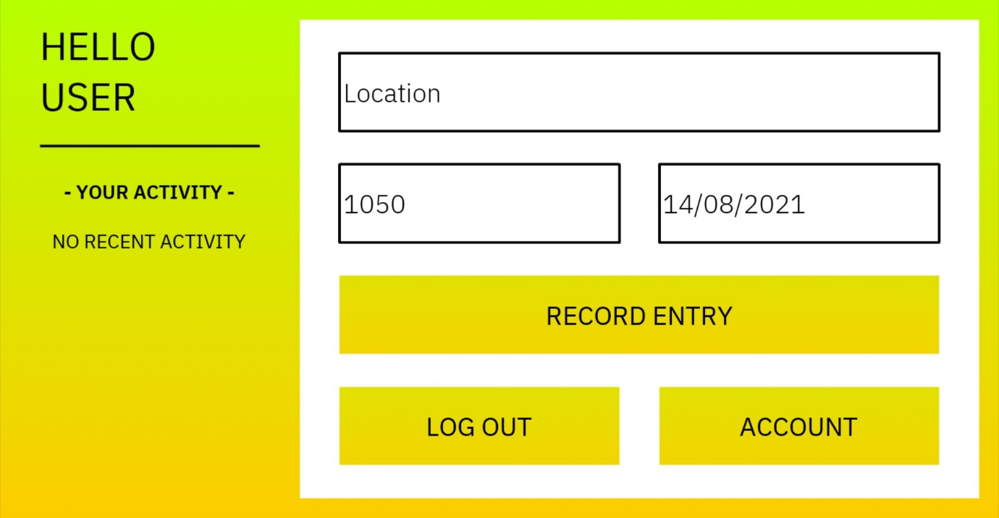
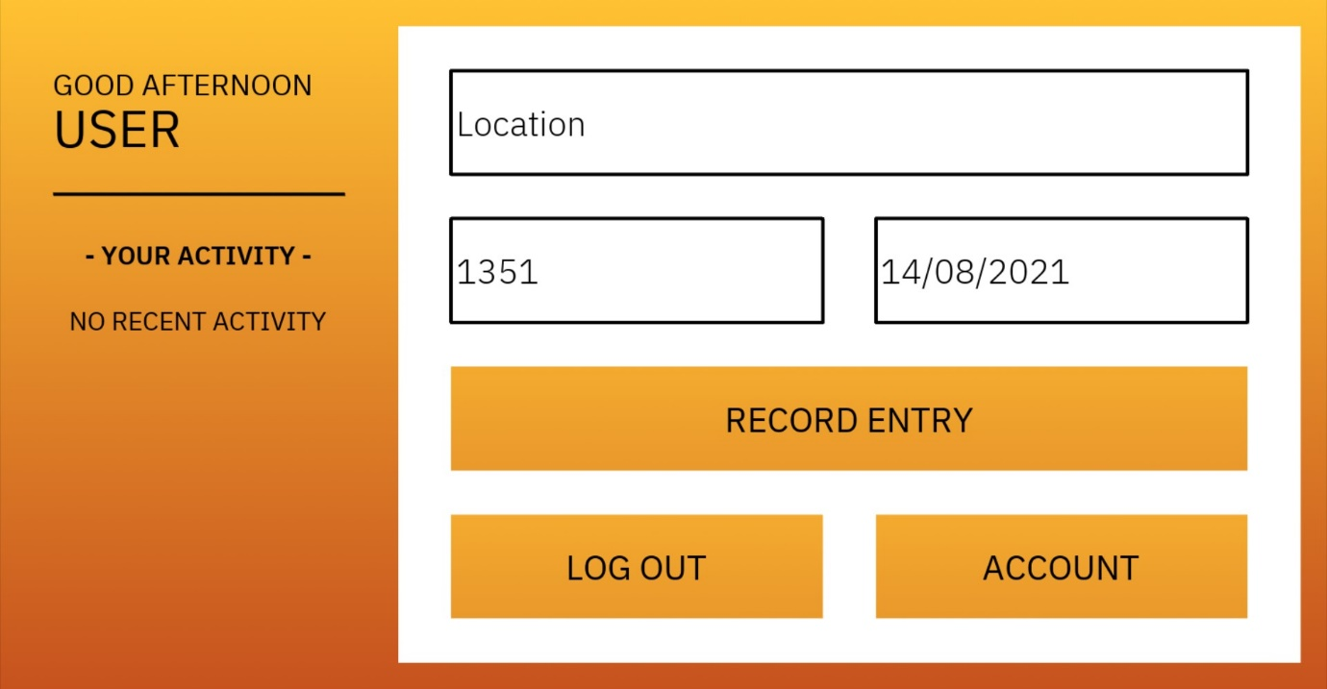
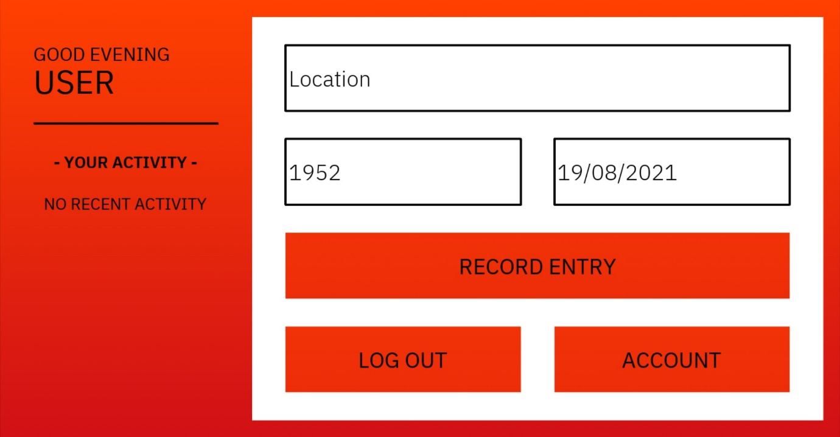
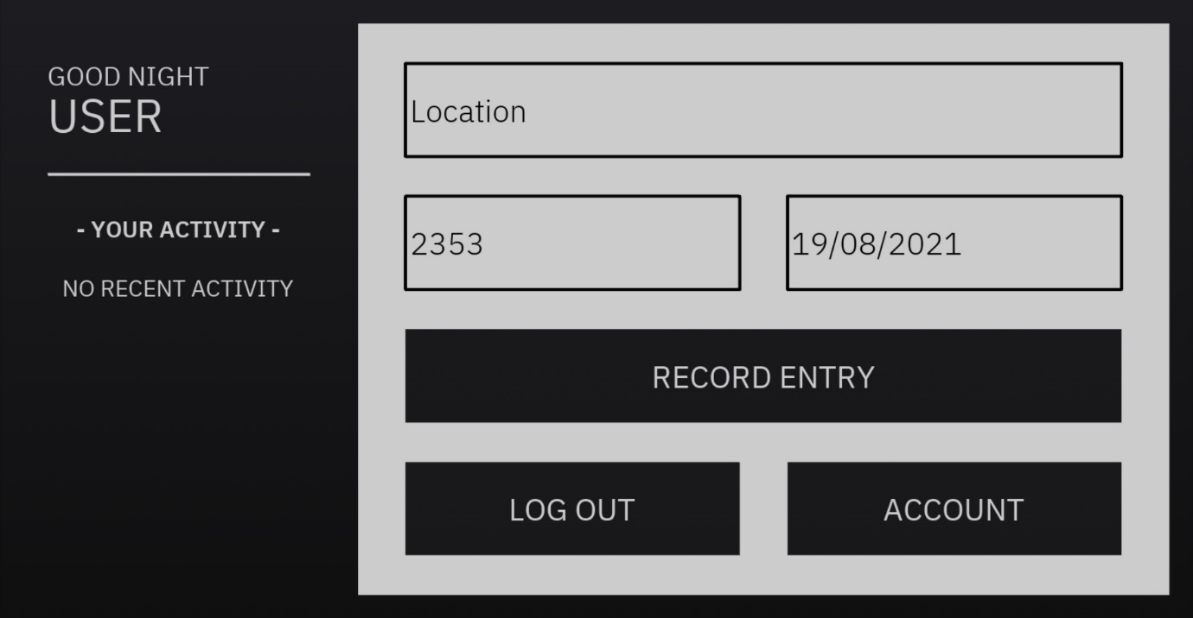
THE FINISHED PROTOTYPE
// TIME DEPENDENT THEMES

Slide 28

WHAT’S NEXT?
If this kind of program is to be used on a global scale, there are two major evolutions that would come next.
Reverse geo-coding is a process that allows location names to be found by matching a device’s longitudinal and latitudinal coordinates to the nearest named address in a database. Adding this feature would make the program significantly easier to use, while removing the possibility of human error.

Slide 29
WHAT’S NEXT?
As mentioned previously, positive feedback is a major factor contributing towards community involvement with contact tracking. In the future this software could be linked to an existing network such as Visa in order to give users that consistently record their location small rewards in the form of vouchers or prizes.

Slide 30
TRY IT OUT!
Download “Contact Tracker - by Ben Hume.zip” from the following link. https://drive.google.com/file/d/1V9FuHVcoDAjyfNs_zN8ujjo_UCFtlmj_/view?usp=sharing
Unzip the package.
On a Windows device, open “Contact Tracker – by Ben Hume/dist/Contact Tracker”
Run “Contact Tracker.exe”
Save the world, one entry at a time.

Slide 31
THANK YOU FOR JUDGING MY ENTRY!
Please feel free to contact me at bhume@students.mags.school.nz

